Slide 1
2Do
Todo App
For Task Management

Slide 2
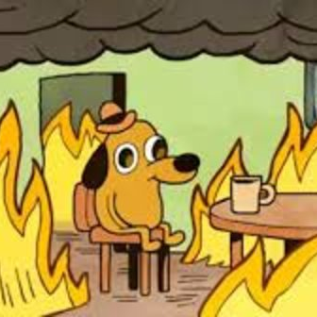
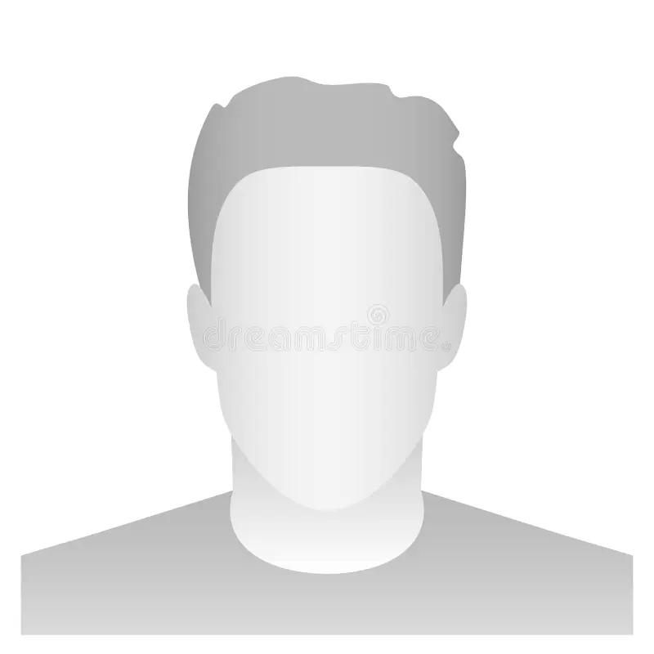
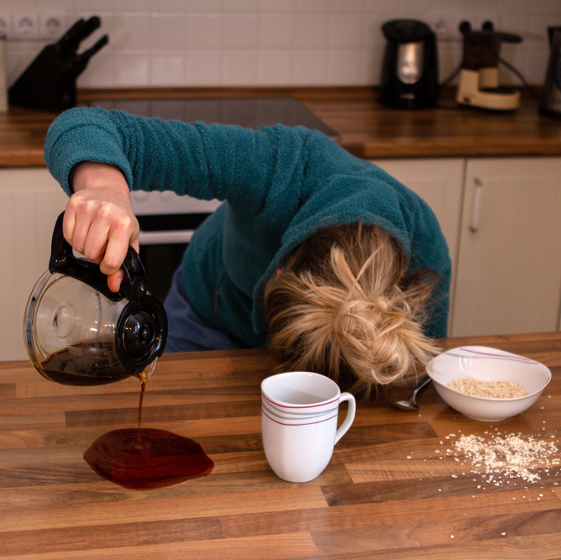
MEET OUR TEAM
Nathan Hajdu
Malek Ghazal
Renata Mattiazzo
Optimistic Realist
No picture since 2016
Tired Mom

Slide 3
AGENDA
Introduction​
App Features
​Implementation
Challenges & Outcomes
​Conclusion

Slide 4
Introduction
Our Flutter 2DO application is designed to streamline your daily task management, ensuring a more organized and productive lifestyle. By providing an intuitive platform, it simplifies the process of creating, tracking, and categorizing your tasks. The app also offers convenient access to weather updates in your city and facilitates personalized user profiles. Its user-friendly interface and functionality make it an ideal tool for staying on top of your tasks and managing your time effectively.

Slide 5
Task Distribution
2Do

Slide 6
Who worked on What
 | Nathan | Malek | Renata
Phase 1 | Created Drawer side menu. Created Add Todo & Todo List widgets. Created default profile, weather, Todos & and Add Todo screens. Corrected main to accommodate drawer routes. Added comments to code for readability. | Initialize project & repository. Created color scheme & Theme. Login page styling. | Created Log In page. Authentication (Google and Anonymous) Firebase and Log In logic.
Phase 2 | Created date picker widget & updated app classes. Implemented due date calendar functionality. | Login page styling. Weather API screen. App styling/theme. | Firestore setup and configuration. Todo JSON data.
Phase 3 | Created ReadMe. Implemented Edit and Delete for Anonymous users. Completed PowerPoint presentation. | Implemented profile picture for users. Code refactoring. Documentation. | Implemented Edit and Delete for Google users. Implemented username update feature.

Slide 7
App Features
2Do

Slide 8
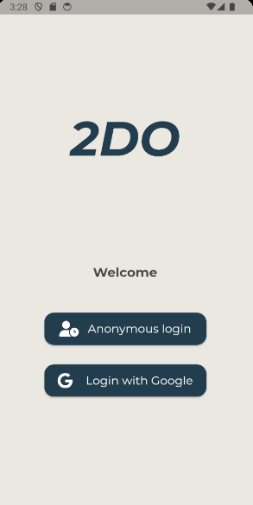
Login Page
Upon launching the app, users are greeted with a login page, offering two options: anonymous login or Google Sign-In.

Slide 9
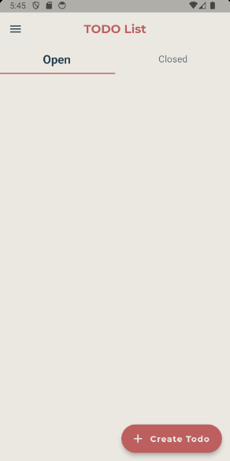
Main Todos
After logging in, users land on the main Todos screen, where they can click the "Create Todo" button to navigate to the "Add New Todo" screen.

Slide 10
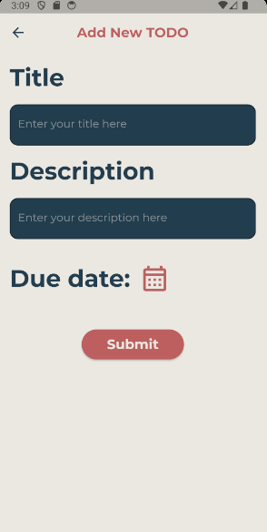
Add New Todo
In the "Add New Todo" screen, users can input a title, description, and choose a due date using a calendar widget.

Slide 11
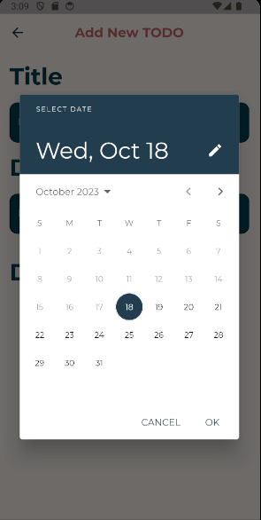
Calendar widget
The calendar widgets brings up a calendar that allows the user to select a due date for their given task.

Slide 12
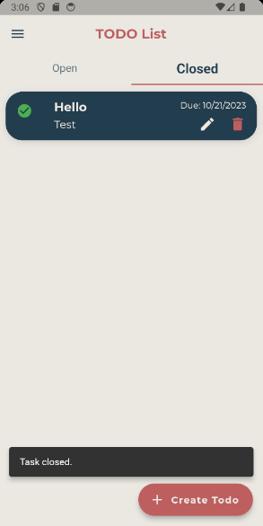
After Creating a task
Once they hit the submit button, they return to the main Todo screen, where their newly created task is displayed, along with edit and delete icons.

Slide 13
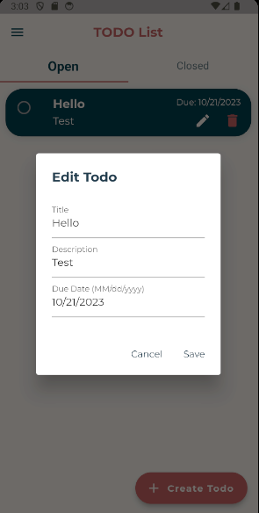
Editing a task
To modify a task, user can simply click on the pencil icon, which opens a modal window for editing the title, description, and date.

Slide 14
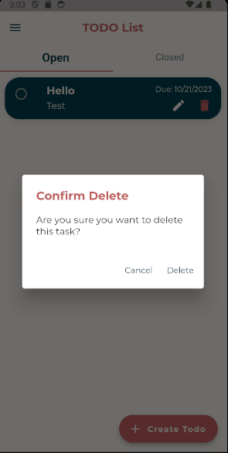
Deleting a task
To delete a task, users can click on the trash can icon, triggering a confirmation window to ensure the user's intent.

Slide 15
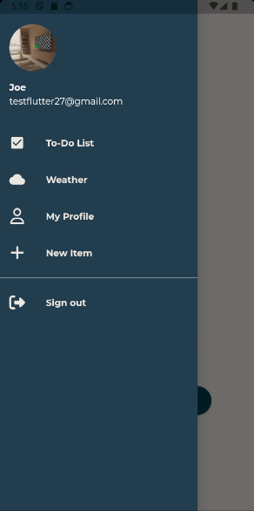
Navigation Drawer
The side menu can be accessed from any screen by clicking on the hamburger menu in the top left corner. It displays the user's profile picture (if added through the profile screen), their email address (for Google sign-ins), or "Anonymous User" if no email is associated. Users can navigate to other app sections such as Todo List, Weather, My Profile, Add New Todo, and Sign Out.

Slide 16
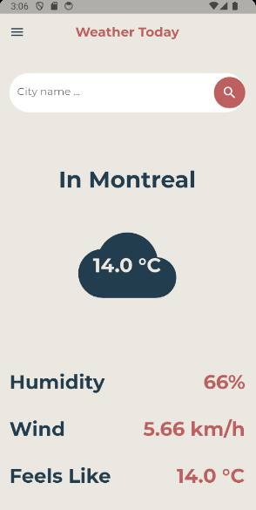
Weather information
Clicking on "Weather" takes users to the weather screen, where they can check weather conditions in their city. Users can update the location to reflect their current city.

Slide 17
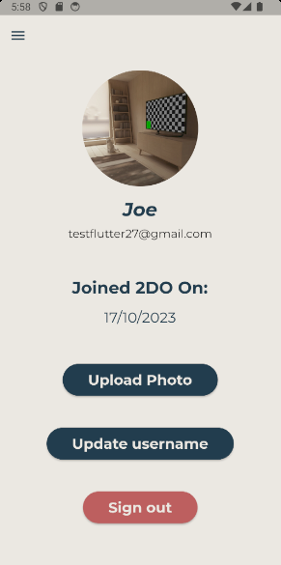
User profile
The "My Profile" screen provides information about the user's registration date, email (for Google sign-ins), and the ability to upload a profile picture or sign out from the app.

Slide 18
Implementation details
2Do

Slide 19
Implementation details
Feature | Implementation
Login / Authentication | The login and authentication logic are encapsulated in the AuthService class. It uses Firebase Authentication for both anonymous and Google Sign-In methods. The LoginCheck widget listens to changes in the user's authentication state and routes the user to the appropriate screen based on their login status. The LoginScreen widget provides the UI for the login options and triggers the authentication methods.

Slide 20
Implementation details
Feature | Implementation
Todos Tabs | The implementation consists of a TodosScreen widget with 'Open' and 'Closed' tabs for managing tasks. It uses the TodoProvider class for state management, allowing the toggling of task statuses, loading more tasks, adding, editing, and deleting them. The TodoProvider maintains separate lists for 'Open' and 'Closed' tasks. The TodosScreen can source tasks from local storage or Google Firestore, offering a flexible data retrieval mechanism. It effectively displays and manages tasks, supporting real-time status updates and user interactions.

Slide 21
Implementation details
Feature | Implementation
Weather API | This weather API implementation comprises three main components: the Weather class, WeatherScreen widget, and WeatherApiClient service. The Weather class models city-specific weather data and facilitates object instantiation through default and JSON-based constructors. The WeatherScreen widget displays real-time weather information for user-specified cities, with a search input and dynamic content, leveraging a FutureBuilder for asynchronous data fetching. The WeatherApiClient service interacts with the OpenWeatherMap API, authenticating requests with an API key, and provides a method for retrieving weather data. Together, these components enable users to access and visualize current weather conditions in different cities efficiently.

Slide 22
Implementation details
Feature | Implementation
Add Todo | The Add Todo implementation consists of the AddTodo widget and the AddTodoScreen widget. The AddTodo widget offers a user interface for entering a new todo item with a title, description, and due date selection. It includes input validation and submission functionality. If the user is authenticated, the todo is added to Firestore, while for anonymous users, it's stored locally. The user receives feedback through snackbar messages on successful additions or errors. The AddTodoScreen widget enhances the user experience by ensuring data integrity and providing feedback, making the todo addition process seamless and user-friendly.

Slide 23
Implementation details
Feature | Implementation
Date Picker / Calendar | The Calendar/Date Picker implementation features a reusable DatePickerWidget that facilitates the selection of due dates with a user-friendly interface. It is prominently utilized in the AddTodoScreen. The date picker is also integrated into the todoList, displayed on the main TodosScreen where users can edit or delete tasks. This implementation enhances the user experience by providing seamless date selection and efficient task management.

Slide 24
Implementation details
Feature | Implementation
Drawer Widget | The TodoDrawer widget is used for app navigation. It displays user information and offers navigation links. It receives a userImage property and utilizes Firebase for user data. The user's name and email are displayed. The profile picture is shown as a circle avatar, with a default placeholder if no image exists. The drawer provides navigation items like "To-Do List," "Weather," "My Profile," and "New Item," each triggering route navigation. An option for user sign-out is also available. The widget simplifies app navigation and user interaction.

Slide 25
Implementation details
Feature | Implementation
Profile / Firestore | The ProfileScreen widget interacts with Firebase Authentication to display user details, allowing profile picture updates, username changes, and account sign-out. User data, including the profile picture, name, and email, is fetched from Firebase. Users can update their profile image using the device's camera. The app displays the date of account creation. Users can change their username, and after sign-out, they are redirected to the login screen. Firebase stores user data, while the profile picture is managed locally.

Slide 26
Challenges & Obstacles
2Do

Slide 27
Challenges & Solutions
 | Nathan | Malek | Renata
Project | Challenge: Initially, all the code for creating and managing todos was handled on a single screen, causing several issues. The code became lengthy and challenging to manage, resulting in errors that were hard to pinpoint and fix. Solution: To overcome this challenge, I implemented a two-fold solution. First, I created a dedicated screen for adding new todos. This separated the task of creating todos from the main display, making it more organized and manageable. Second, I developed a separate widget responsible for listing and displaying todos on the main todos page. This restructuring improved code modularity and helped in isolating and resolving errors effectively. | Challenge: Initially, all the code for creating and managing todos was handled on a single screen, causing several issues. The code became lengthy and challenging to manage, resulting in errors that were hard to pinpoint and fix. Solution: To overcome this challenge, I implemented a two-fold solution. First, I created a dedicated screen for adding new todos. This separated the task of creating todos from the main display, making it more organized and manageable. Second, I developed a separate widget responsible for listing and displaying todos on the main todos page. This restructuring improved code modularity and helped in isolating and resolving errors effectively. | Challenge: I tried to merge the Google Todos screen with the Anonymous but, due to the todos_list widget, it wasn’t working. Solution: I had to create a new todo_list widget for Google users using Material instead of List View.

Slide 28
Conclusion
In conclusion, our journey in developing this project has been marked by numerous challenges and triumphs. From streamlining the codebase to enhancing user experiences, we tackled each obstacle with dedication, communication and teamwork.
We learned that in software development, flexibility, adaptability, and a willingness to explore new solutions are vital.
Throughout this process, we've crafted innovative solutions, strengthened our technical skills, and discovered that effective development is a synergy of adaptability, organization, and relentless learning.

Slide 29
THANK YOU
Enjoy using the Flutter 2DO app for efficient task management and staying updated on the weather, all in one convenient application!
-Nathan Hajdu -Malek Ghazal -Renata Mattiazzo

